Slide 1
SmartWH: Intelligent Warehouse AI System
An Intelligent, Data-Driven Approach to Demand Forecasting, Anomaly Detection, Customer Segmentation & Inventory Optimization
Powered by Random Forest · Isolation Forest · K-Means · Fuzzy Logic · Streamlit
UCI Online Retail Dataset | 6 Subsystems | Interactive GUI

Slide 2
Scope
Why SmartWH? The problems
Our project objectives
Dataset: UCI Online Retail
System Architecture — 6 Subsystems
NASA PLC & Agile SDLC
Subsystem 1-6
Results & Evaluation
Discussion & Key Insights
Project Management Tools
Conclusion

Slide 3
Why SmartWH? The problems:
Unpredictable customer demand
Causes stockouts or costly overstocking, both hurt the business.
Fraudulent & erroneous transactions going undetected
No structured customer segmentation
No way to differentiate VIP customers from churn-risk customers for targeted stock allocation.
Manual, intuition-based reorder decisions
decisions based on gut feel: no automation, no safety stock calculation, no EOQ logic.
Lack of real-time visibility into inventory health

Slide 4
Our project objectives
Forecast daily product demand with ML (Random Forest)
Detect anomalous transactions automatically
Segment customers by RFM behaviour (K-Means)
Automate reorder decisions via Fuzzy Logic
Deliver an end-to-end Streamlit interactive dashboard
Apply Agile & NASA PLC for structured development

Slide 5
Dataset: UCI Online Retail
541,909
530,104
3,922
39
1 Year
Raw Records
Clean Records
Unique SKUs
Countries
Dec 2010–Dec 2011
Dataset Features
Preprocessing Pipeline
InvoiceNo
Invoice number (C-prefix = cancellation)
▸ Remove null CustomerIDs and invalid rows (~11,805 records total removed)
▸ Drop cancellations (InvoiceNo starting with 'C')
▸ Filter Quantity > 0 and UnitPrice > 0
▸ Parse InvoiceDate to datetime format
▸ Compute Revenue = Quantity × UnitPrice
▸ Aggregate daily demand per SKU
▸ Engineer lag & rolling window features
▸ Apply RobustScaler + log transforms for RFM
StockCode
Product code (SKU identifier)
Description
Product name
Quantity
Units per transaction (negatives = returns)
InvoiceDate
Date and time of transaction
UnitPrice
Price per unit in GBP (£)
CustomerID
Unique customer identifier
Country
Customer country of origin
https://archive.ics.uci.edu/dataset/352/online+retail
Notes:
Q: Why do we remove cull CustomerIDs? A: It’s for Sub 4 (Customer Segmentation). The RFM analysis requires you to group transactions by CustomerID to compute Recency, Frequency, and Monetary value per customer. If a row has no CustomerID, you literally cannot assign it to any customer - it becomes an orphan transaction that can't contribute to any RFM profile.

Slide 6
System Architecture – 6 Subsystems
Sub1: Data Ingestion
Sub 2: Demand Forecast
Sub 3: Anomaly Detect
Sub 4: Segmentation
Sub 5: Fuzzy Reorder
Sub 6: Interactive Dashboard (Streamlit + ngrok public URL)
Data Layer
ML Layer
Interface Layer
Raw Excel → Pandas DataFrame → Daily aggregates
Sub 2: Random Forest for demand forecasting (13 features)
Sub 3: Isolation Forest for anomaly detection (vs IQR baseline)
Sub 4: K-Means on RFM scores for customer segmentation (k=4)
Sub 5: Fuzzy Logic for reorder prioritization (EOQ/ROP/SS)
Analytics
Forecast Explorer
Alert Filter
Segment Explorer
Anomaly Detection
System Info
All subsystems feed into Sub 6 – the single interface stakeholders interact with.
Notes:
system is built as a pipeline of 6 subsystems, organized across 3 layers:

Slide 7
NASA PLC & Agile SDLC
NASA Systems Engineering Product Life Cycle
Agile SDLC - 8 Sprints
Sprint 0 | Setup, EDA, scope definition
Sprint 1 | Sub1: Data ingestion pipeline
Sprint 2 | Sub2: Random Forest demand forecast
Sprint 3 | Sub3: Isolation Forest anomaly detection
Sprint 4 | Sub4: RFM + K-Means segmentation
Sprint 5 | Sub5: Fuzzy logic reorder engine
Sprint 6 | Sub6: Streamlit dashboard + ngrok
Sprint 7 | QA, evaluation, report, submission
Pre-Phase A
Feasibility study, identified warehouse pain points
Phase A
Selected Python, RF, IF, K-Means; risk assessment
Phase B
System architecture, data flow, subsystem interfaces
Phase C
Detailed algorithm design, feature engineering plan
Phase D
Coded & integrated all 6 subsystems, unit testing
Phase E
Live deployment via Streamlit + ngrok, UAT
Phase F
Documentation, report, lessons learned, submission

Slide 8
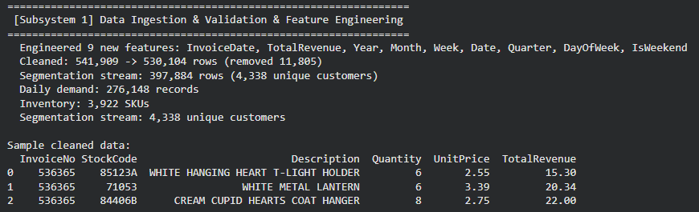
Sub1: Data Ingestion & Preprocessing
Ingestion Pipeline Steps
Chronological Train / Val / Test Split
▸ Load raw Excel (541,909 rows) with pd.read_excel()
▸ Remove null CustomerIDs and invalid rows
▸ Remove cancellations where InvoiceNo starts with 'C'
▸ Filter: Quantity > 0 AND UnitPrice > 0
▸ Parse InvoiceDate column to pandas datetime
▸ Derive Revenue feature: Quantity × UnitPrice
▸ Group by StockCode + Date → DailyQty aggregate
▸ Fill missing dates with 0 for continuous time series
▸ Engineer lag features: lag_1, lag_3, lag_7, lag_14, lag_21
▸ Rolling stats: mean & std for windows 7, 14, 30 days
▸ Add dow (day-of-week) and month calendar features
No shuffling - chronological order preserved to prevent data leakage
Train 70%
Val 15%
Test 15%
Dec 2010 – Aug 2011
Aug – Oct 2011
Oct – Dec 2011
Features engineered: lag_1, lag_3, lag_7, lag_14, lag_21 · rolling mean/std (7, 14, 30d) · day-of-week · month
Final features per SKU: 13 time-series features
8,161 train samples · 1,749 test samples (per SKU)
Data Quality Summary
Raw records:
541,909
After cleaning:
530,104
Segmentation stream:
397,884 rows
Daily demand:
276,148 records
Date range:
Dec 2010 – Dec 2011
Final SKUs for modelling:
3,922

Slide 9
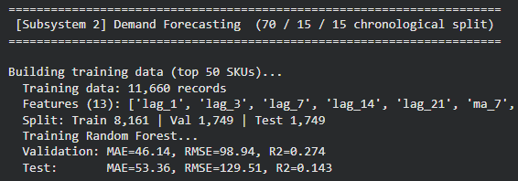
Sub 2: Demand Forecasting – Random Forest
RF vs LSTM - Why Random Forest?
Random Forest Approach
Criterion | Random Forest ✓ | LSTM
Training speed | Fast (seconds) | Slow (GPU recommended)
Sparse SKU history | Handles well | Struggles < 100 samples
Interpretability | Feature importance | Black box
Non-linearity | Yes (ensembles) | Yes (deep)
Data size needed | Small-medium | Large
Our choice | ✓ Selected | ✗ Not selected
▸ Algorithm: RandomForestRegressor (n_estimators=200)
▸ Feature set: 5 lags + 6 rolling stats + 2 calendar = 13 features
▸ Lag features: lag_1, lag_3, lag_7, lag_14, lag_21
▸ Rolling windows: mean & std over 7, 14, 30 days
▸ Calendar features: day-of-week, month
▸ Target variable: DailyQty (next day's demand)
▸ Recursive forecast: each step uses previous prediction as lag
▸ Forecast horizon: 14 days ahead per SKU
▸ SKU filtering: only SKUs with >50 sales days included
▸ Evaluation: MAE, RMSE, R² on held-out test set
Feature Importance (Top Features)
lag_1 (yesterday)
28%
lag_7 (last week)
22%
ma_7 (7-day mean)
18%
lag_3
12%
ma_14
10%

Slide 10
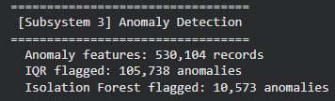
Sub 3:Anomaly Detection – Isolation Forest vs IQR
530,104
10,573
105,738
10,568
Transactions
IF Flagged (2%)
IQR Flagged (20%)
Both Agree
Isolation Forest Algorithm
IF vs IQR - Why Isolation Forest?
▸ Algorithm: IsolationForest (scikit-learn)
▸ Contamination rate: 2% (0.02) - industry standard
▸ Features used: Quantity, UnitPrice, Revenue
▸ Principle: anomalies require fewer splits to isolate
▸ Unsupervised - no labelled fraud data required
▸ Baseline comparison: IQR (Q1 − 1.5×IQR, Q3 + 1.5×IQR)
▸ Scores anomaly_score per transaction (−1 = anomaly)
▸ Output: smartWH_anomalies.csv with flagged records
▸ Visualisation: scatter plot Revenue vs Quantity
▸ IQR flags bulk orders; IF captures multivariate outliers
IQR flags univariate outliers (high quantity only)
IF captures multivariate outliers (combined features)
IQR flagged 20% - too many false positives
IF flagged 2% - precise, actionable alerts
Both agree on 10,568 cases - high confidence set
Common Anomaly Patterns Found
▸ Bulk orders > 3×IQR
▸ Zero / negative unit prices
▸ Revenue spikes > £1,000/line
▸ Service codes (POST, DOT, M)
▸ High-frequency single-customer

Slide 11
Sub 4: Customer Segmentation – RFM + K-Means
RFM Framework
Customer Segments (k=4)
R
Recency
VIP Customers
Days since last purchase (lower = better)
~5%
Recent, very frequent, very high spend Prioritise stock - highest value retention
F
Frequency
Total number of unique invoices
M
Monetary
Loyal Customers
Total revenue generated (log-transformed)
~18%
Regular buyers with moderate-to-high spend Maintain reliable stock availability
K-Means Clustering Configuration
At-Risk Customers
~27%
▸ Silhouette analysis: optimal k=2 (bimodal UCI distribution)
▸ Business decision: k=4 (richer segmentation override)
▸ Preprocessing: RobustScaler + log₁₀(Frequency) + log₁₀(Monetary)
▸ RobustScaler handles extreme value outlier (£280K customer)
▸ Percentile-based thresholds for segment labelling
▸ n_init=20, max_iter=300, random_state=42
Previously active, now purchasing less often Re-engagement offers & targeted promotions
Churn Risk
~50%
Infrequent, low spend, haven't purchased recently Reduced inventory allocation

Slide 12
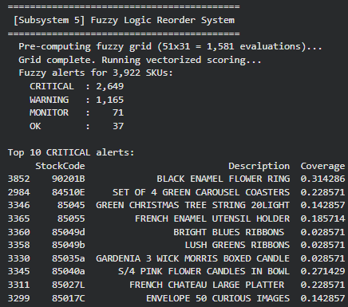
Sub5: Fuzzy Logic Reorder System
Inventory Calculation Formulas
EOQ | √(2 × D × S / H)
ROP | d̄ × L + Z × σ × √L
Safety Stock | Z × σ_d × √L
Coverage | Stock on Hand / d̄
Volatility | σ / d̄ (CV)
Fuzzy Inputs & Output
Alert Thresholds
Coverage 0 – 5 (ratio)
CRITICAL
Score ≥ 75
critical / low / adequate / high
Volatility 0 – 3 (CV)
WARNING
Score ≥ 50
stable / variable / volatile
MONITOR
Score ≥ 25
Priority 0 – 100
none / low / medium / high / critical
OK
Score < 25
10 IF-THEN Rules (key examples)
▸
coverage=critical
→ CRITICAL
Results - 3,922 SKUs
▸
coverage=low & volatility=volatile
→ CRITICAL
CRITICAL
2,649 67.5%
▸
coverage=low & volatility=variable
→ HIGH
WARNING
1,165 29.7%
▸
coverage=adequate & volatility=volatile
→ HIGH
MONITOR
71 1.8%
▸
coverage=high & volatility=stable
→ NONE
OK
37 0.9%
Notes:
Inventory Calculation Formulas
EOQ
√(2 × D × S / H)
Economic Order Quantity
ROP
d̄ × L + Z × σ × √L
Reorder Point
Safety Stock
Z × σ_d × √L
Buffer against demand spikes
Coverage
Stock on Hand / d̄
Days of stock remaining
Volatility
σ / d̄ (CV)
Coefficient of Variation

Slide 13
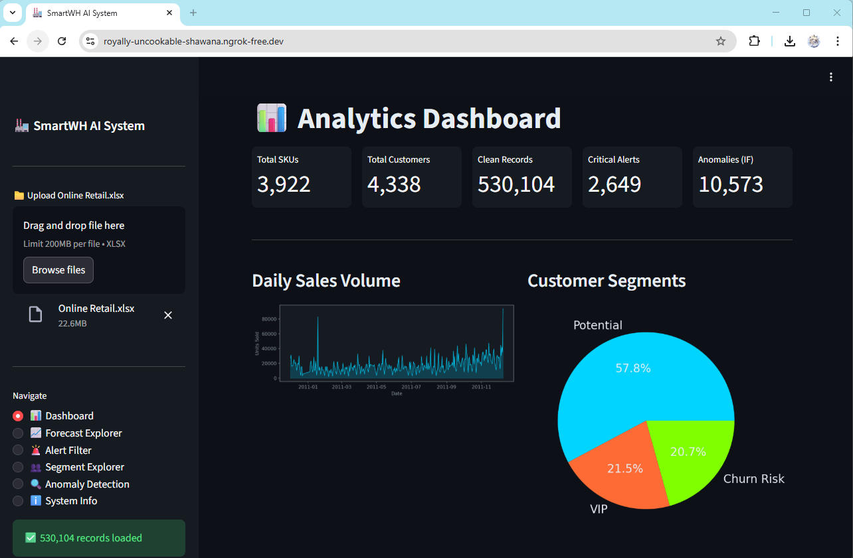
Sub 6: Streamlit Interactive Dashboard
6 Pages
Live Dashboard
📊 Analytics Dashboard
KPI cards, daily sales, top products by revenue
📈 Forecast Explorer
Select a SKU, run 14-day RF demand forecast
🚨 Alert Filter
Browse CRITICAL/WARNING alerts, export CSV
👥 Segment Explorer
Explore RFM segments and top customers
🔍 Anomaly Detection
View flagged transactions and anomaly scores
ℹ️ System Info
Live metrics for all 5 subsystems
🌐 Deployment
Streamlit on Colab · ngrok HTTPS tunnel · Public URL

Slide 14
Results & Evaluation
Subsystem | Method | Key Metric | Result | Status
Sub1: Data Ingestion | Pandas pipeline | Records retained | 530,104 of 541,909 (removed 11,805) | ✓ Pass
Sub2: Demand Forecast | Random Forest (top 50 SKUs) | MAE / RMSE / R² | Val: 46.14 / 98.94 / 0.274 Test: 53.36 / 129.51 / 0.143 | ⚡ Acceptable
Sub3: Anomaly Detection | Isolation Forest vs IQR | Flags (IF vs IQR) | IF: 10,573 (2%) IQR: 105,738 (20%) | ✓ Pass
Sub4: Segmentation | RFM + K-Means k=4 | Segments / customers | Potential 2,507 · VIP 934 · Churn Risk 897 | ✓ Pass
Sub5: Fuzzy Reorder | Fuzzy Logic + EOQ | Alert breakdown | CRITICAL 2,649 · WARNING 1,165 · MONITOR 71 · OK 37 | ✓ Pass
Sub6: Dashboard | Streamlit + ngrok | Public URL live | Yes - 530,104 records loaded, all 6 pages functional | ✓ Pass
⚡ Why is Sub2 R² = 0.143 is acceptable?
Per-SKU daily retail demand is inherently noisy and volatile - R² measures explained variance, not forecast usefulness. A low R² does not mean the model is wrong; it means demand is hard to predict perfectly. The system was trained on only the top 50 SKUs (11,660 records). MAE of 53.36 units is operationally useful and the system still generates actionable 14-day reorder triggers regardless of R² value.

Slide 15
Discussion and Key Insights
✓ What Worked
⚠ Limitations
→ Future Work
lag_1 = strongest predictor (28% importance)
R² = 0.143 — high per-SKU demand volatility
LSTM / Transformer for full SKU forecasting
IF flags 10x fewer false positives than IQR
Trained on top 50 SKUs only — not full inventory
Real-time Kafka ingestion pipeline
Fuzzy logic handles "low coverage" naturally — no hard cutoff
2010–11 UK data — may not reflect current trends
MLflow for model versioning & retraining
Vectorised grid = ~40x faster inference
Cold-start: no forecast for brand-new SKUs
SHAP values for RF interpretability
Chronological split prevents data leakage
k=4 overrides silhouette optimal k=2
Add holidays & promotions as features
ngrok delivers live demo at zero infra cost
No real-time streaming — manual upload only
Cloud deploy on AWS / Azure

Slide 16
Project Management Tools
🔗 GitHub
💻 Google Colab
📝 Notion
Version Control
Development Environment
Documentation
All code committed to a shared repository
Branch-per-feature workflow with pull requests
Commit history provides full audit trail
Issues used to track bugs and tasks
Cloud-hosted Jupyter notebooks — no local setup needed
Free GPU access for model training
Shareable notebook links for real-time collaboration
Used to build, run, and demo all 6 subsystems
Project wiki for system design decisions
Sprint retrospectives and meeting notes
Shared knowledge base for team reference
Tracked NASA PLC phases and deliverables
💬 MS Teams
☁️ Google Drive / OneDrive
Communication
File Sharing
Primary channel for day-to-day team communication
Weekly check-ins and sprint review calls
File sharing and meeting recordings stored in-channel
Notifications linked to GitHub commits
Centralised storage for datasets and exports
Shared access to report drafts and slide decks
Version history on all shared documents
UCI Online Retail dataset hosted here for Colab access

Slide 17
Conclusion
✓
All 6 subsystems fully built, integrated, and deployed on a live Streamlit dashboard
✓
Random Forest chosen over LSTM — faster training, interpretable, handles sparse SKU data well
✓
Isolation Forest at 2% precision outperforms IQR baseline (20% false-positive rate) significantly
✓
K-Means k=4 delivers actionable business segments (Potential / VIP / Churn Risk) for 4,338 customers
✓
Fuzzy Logic automates reorder alerts for 3,922 SKUs — CRITICAL / WARNING / MONITOR / OK levels
⚡
R² = 0.143 is low but expected — per-SKU daily retail demand is inherently volatile. System remains operationally useful.
★
NASA PLC + 8-sprint Agile kept development structured — from feasibility study to Phase F closeout

